Slide 2
Biologically inspired algorithms Exercise 3
Ing. Lenka Skanderová, Ph. D.

Slide 3
Content
Simulated annealing algorithm

Slide 4
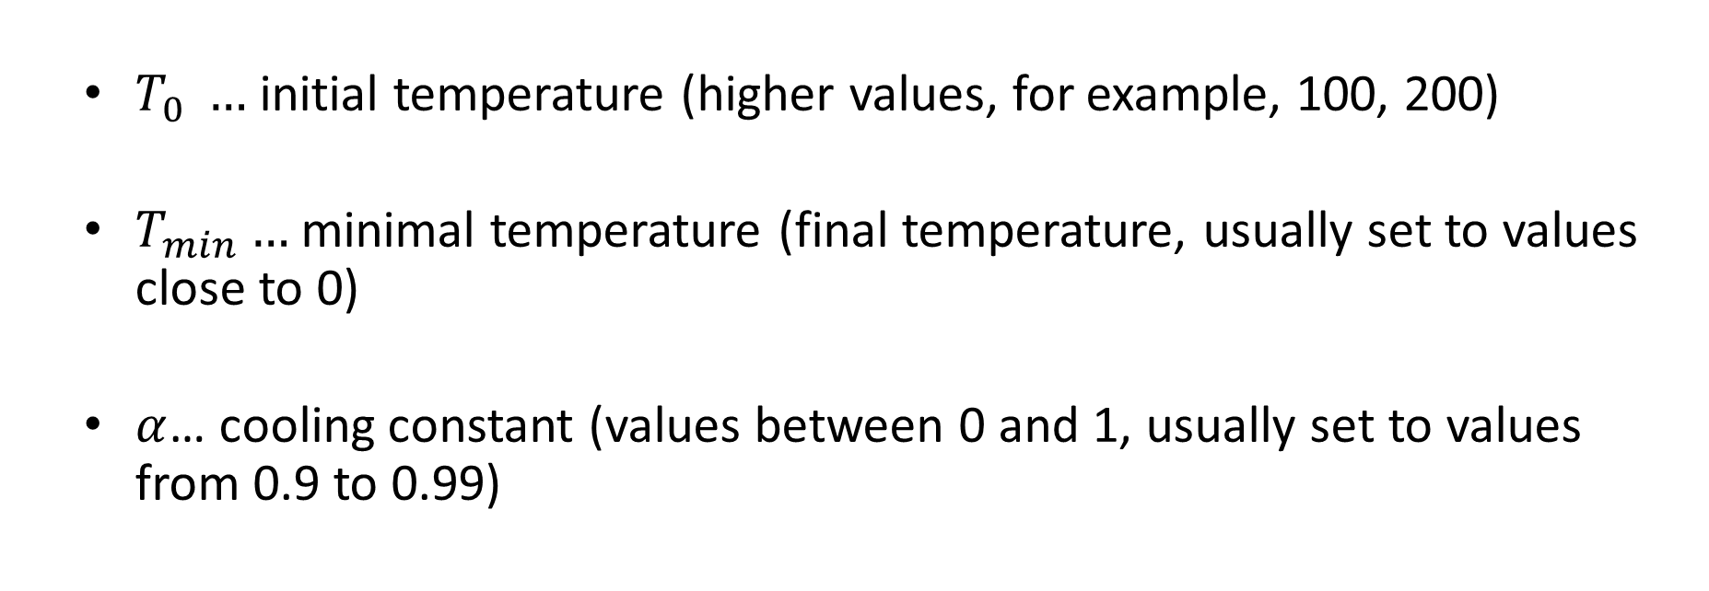
Simulated Annealing – Control parameters
$T_{0} …$ initial temperature (higher values, for example, 100, 200)
$T_{min}…$ minimal temperature (final temperature, usually set to values close to 0)
$α$… cooling constant (values between 0 and 1, usually set to values from 0.9 to 0.99)

Slide 5
Simulated Annealing – Pseudocode
# Setting of control parameters
#---------------------------------
T_0 = 100
T_min = 0.5
alpha = 0.95
#---------------------------------
T = T_0
# Generation of initial solution
#---------------------------------
x = generate initial solution
Evaluate x
# Main loop
#----------------------------------------------------
while T > T_min:
x_1 = generate neighbour of x in normal distribution
Evaluate x_1
if f(x_1) < f(x):
x = x_1
else:
r = random number in uniform distribution
if r < e^{-(f(x_1)-f(x))/T}:
x = x_1
T = T*alpha

Slide 6
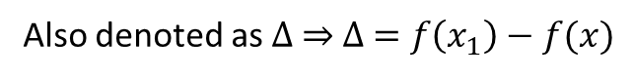

Simulated Annealing – Pseudocode
Important row in pseudocode:
if r < e^{-(f(x_1)-f(x))/T}:
Also denoted as $∆ ⇒$ $∆ =f\left(x_{1}\right)−f(x)$
With decreasing value of $T$ the probability to accept the worse solution decrease

Slide 7
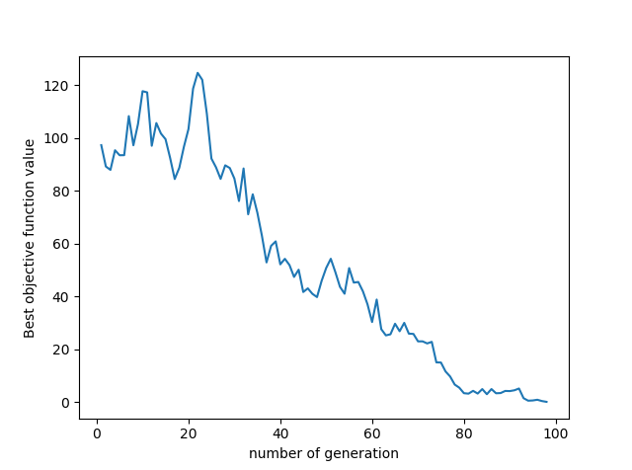
Simulated Annealing – Behaviour
Worse solutions are accepted at the beginning of the algorithm
At the end of algorithm, same behavior as Hill Climbing
Sphere function

Slide 8
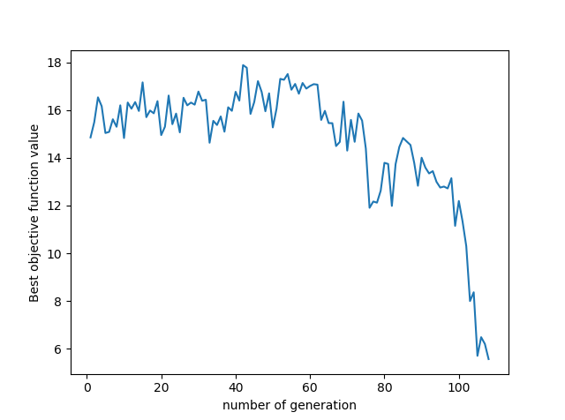
Simulated Annealing – Behaviour
Worse solutions are accepted at the beginning of the algorithm
At the end of algorithm, same behavior as Hill Climbing
Ackley function
Rosenbrock function

Slide 9
Task
Implement Simulated annealing algorithm
Visualize the process of search for the global optimum in 3-dimensional space or using heat maps. Use the test functions implemented for Task 1
Figure 1 and 2 serve as the inspiration for your solution
You can choose one of these approaches or implement both of them
Sometimes, heat map is more useful for illustration of algorithm behaviour
Figure 2: Simulated annealing used for Ackley function – Heat map
Figure 1: Simulated annealing used for Sphere function – 3D

Slide 10
Thank you for your attention
Ing. Lenka Skanderová, Ph.D.
EA 407
+420 597 325 967
lenka.skanderova@vsb.cz
homel.vsb.cz/~ska206

